Slide 1
WIDS - IPL DATA ANALYSIS PROJECT REPORT
S Ramana (20b030036)

Slide 2
About IPL
IPL is a T20 cricket league conducted by BCCI yearly. It is usually held between March and May of every year. It is one of the world’s biggest domestic cricket tournaments.
This tournament started in 2007 and has been a huge hit ever since. It is contested between 10 teams (8 teams for a few years in between). Each teams consists of players all over the world acquired through a system of auctions.
Till now, 14 seasons of IPL have been completed, and the league just keeps getting more popular. The venues are mostly in India with exceptions of South Africa and The UAE, where IPL’s were conducted due to matches not being able to be played in India.

Slide 3
Scope of the project
With the IPL getting bigger by the day, it involved Big money and the stakeholders involved are trying their best to do everything they can for their team to get an edge over the others.
Having already completed 14 seasons, there is enough data about the players, teams and venue to work with in order to roll out statistics and predictions.
This project revolves around being able to extract meaningful information and statistics from the data available using exploratory data analysis and trying to predict the winner and score of the match after each ball using various machine learning and deep learning algorithms.

Slide 4
Data for the project
The data required for the project was taken from www.kaggle.com. Two datasets have been used. One for overall matches data and one for ball-to-ball data for the full 2008-2020 period. Both the datasets are linked by the ’id’ column which represents the matches uniquely.
Both datasets have been merged into a single dataset and unnecessary columns and columns with too many missing values have been removed with the other missing values being replaced by suitable alternatives. Wrong spellings and duplicate entries were also corrected. New columns have been introduced for cumulative runs and wickets of a match, denoting a unique innings and the total score of an innings, to aid with the analysis process.

Slide 5
Interesting insights drawn from the datasets using Exploratory Data Analysis.

Slide 6
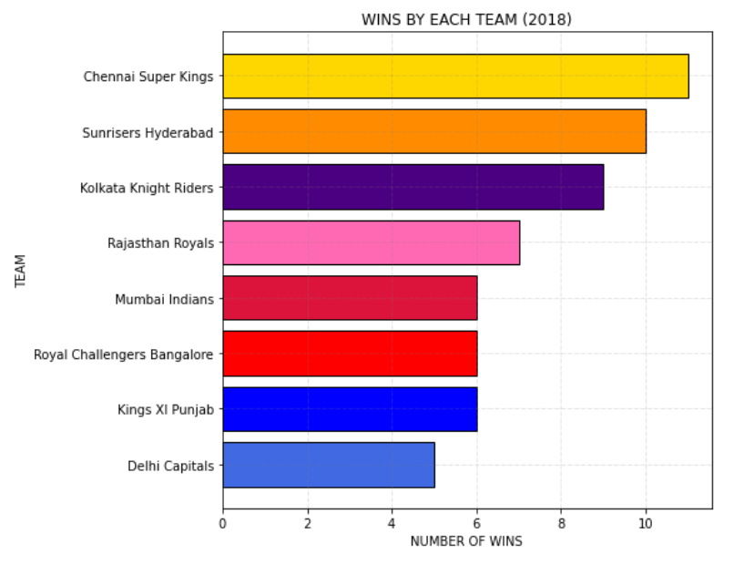
Which Team on the most number of games in 2018 season ?
Chennai Super Kings won the most number of matches in 2018, winning 11 matches.
Sunrisers Hyderabad stands second with 10 wins.

Slide 7
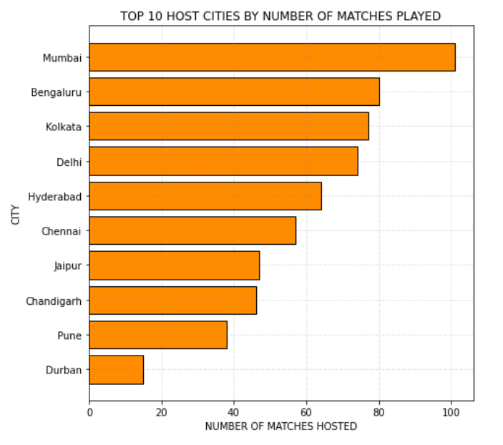
Which city hosted the maximum number of IPL Matches ?
Mumbai has hosted more than 100 IPL matches which is the highest amongst all the venues.
Bengaluru and Kolkata occupy the 2nd and 3rd place respectively with close to 80 matches hosted each

Slide 8
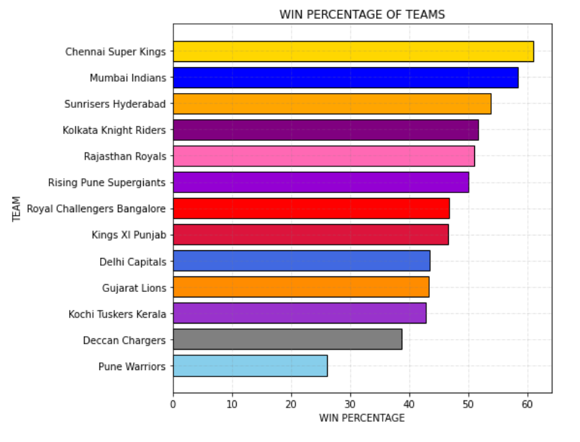
Which is the most successful IPL Team ?
Chennai super Kings is the most successful team with a win percentage of 60.97%
Its arch rival Mumbai Indians is not far away with about 58.29% win percentage and claims the second place

Slide 9
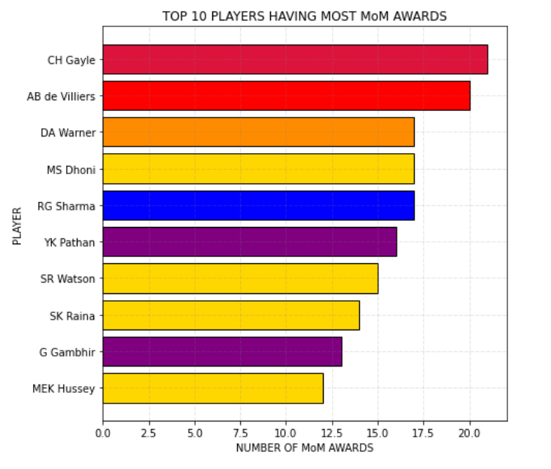
Which player won the most number of MoM Awards ?
Chris Gayle won the most amount of Man of the Match Awards having received 21 of them.
AB de Villiers gets the second place with 20 Man of the Match awards

Slide 10
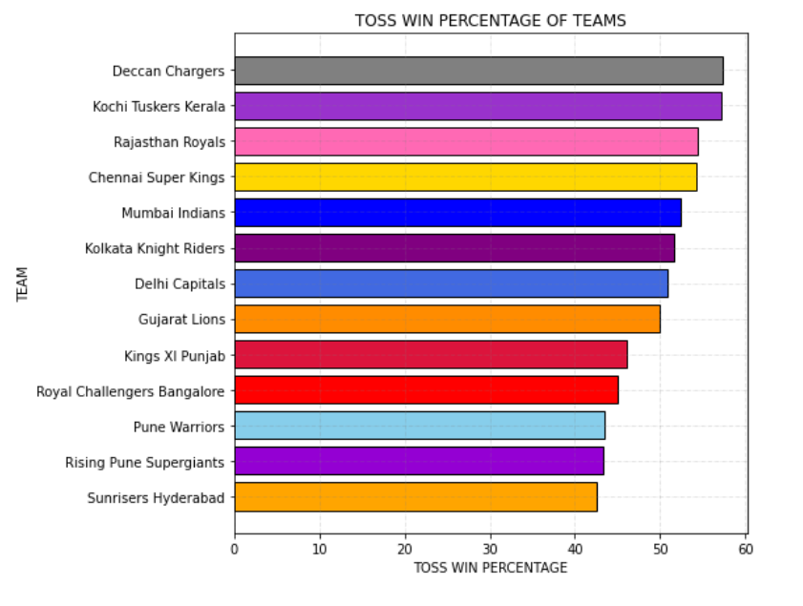
Which Team has won the most amount of tosses ?
Deccan Charges Has the highest toss win percentage, having had won 57.33% of the tosses.
The team with the worst toss win percentage is Sunrisers Hyderabad.

Slide 11
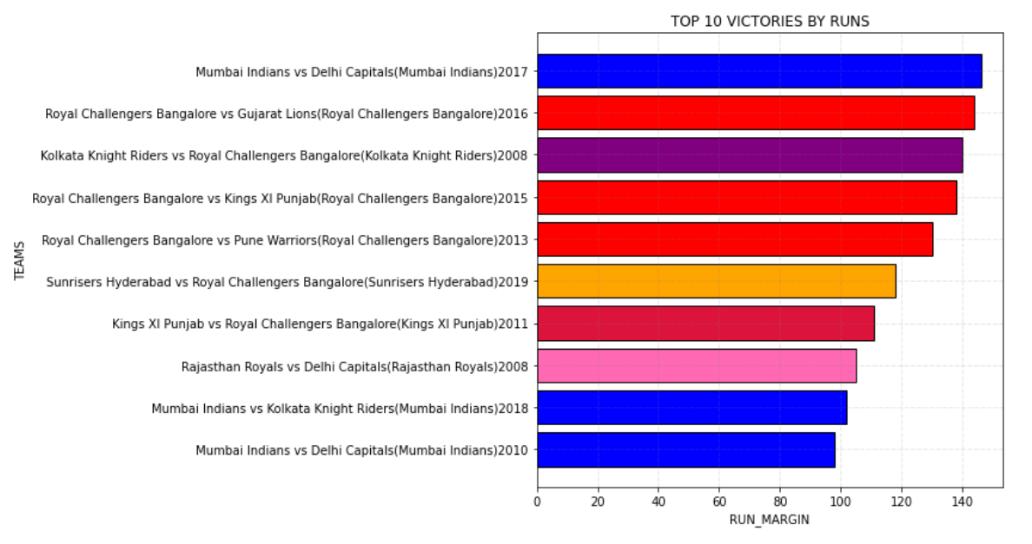
Top 10 Greatest victories in IPL History by runs !

Slide 12
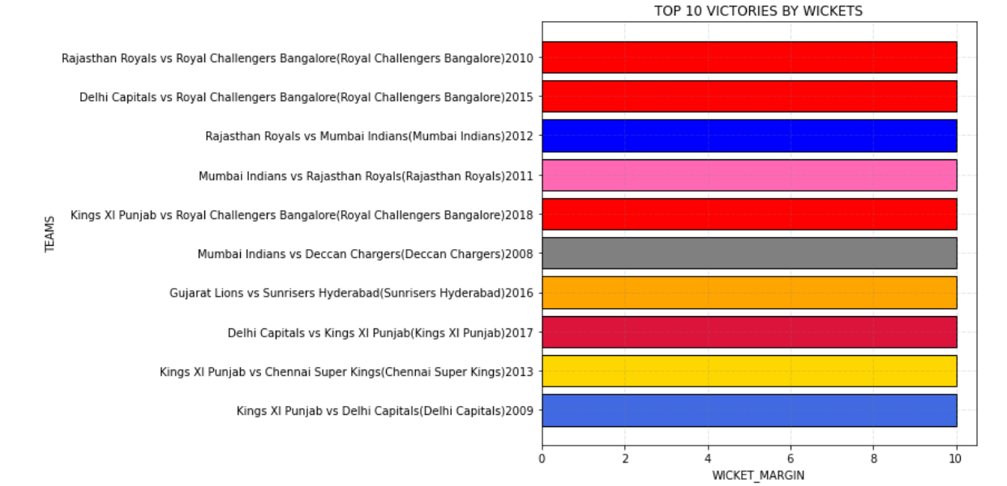
Top 10 Greatest victories in IPL History by wickets !
All by 10 wickets !

Slide 13
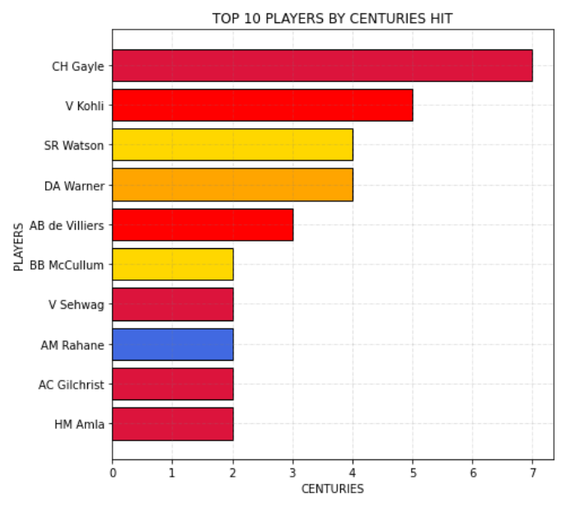
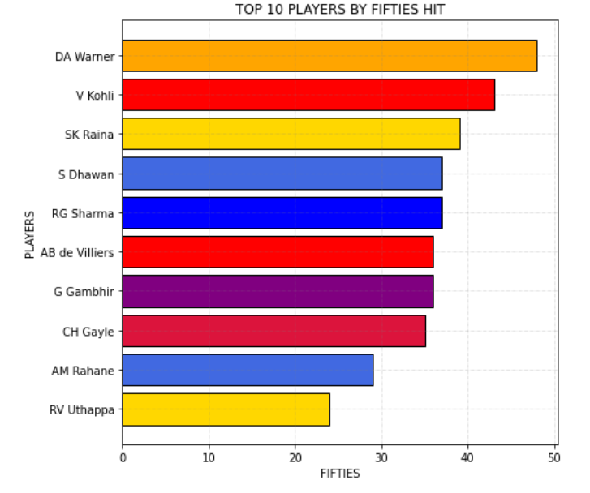
Most number of centuries
Most number of fifties
Chris Gayle has maximum 100’s
David Warner has maximum 50’s

Slide 14
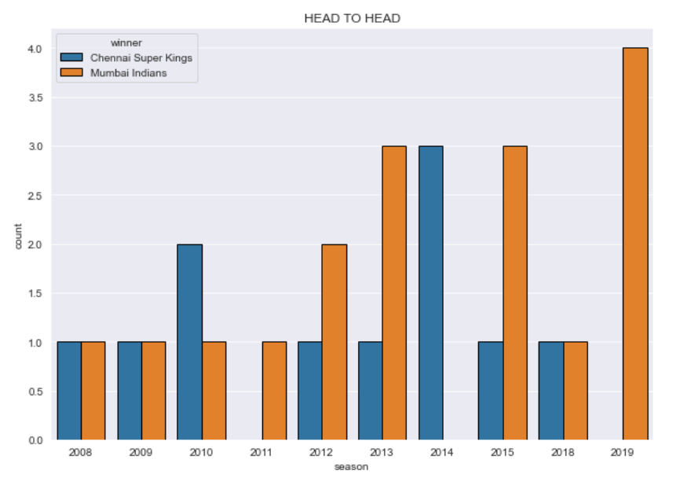
CSK vs MI : Head to Head in each season

Slide 15
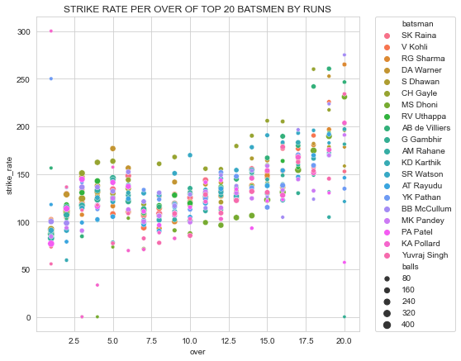
Mean Strike Rate of each Batsman by over

Slide 16
Machine Learning Models

Slide 17
Ball by Ball Win Predictor
Data containing the information of the teams playing the match, the venue, the toss winner, the toss decision , the information about over and ball, the runs scored and wickets fallen so far have been inputted and trained using various classifier algorithms such as Random Forest Classifier, Decision Tree Classifier, Logistic Regression and Gradient Boosting Classifier have been used to give an output prediction of the winner of the match after each ball.
An 80:20 train:test split is done on the data to obtain the training and testing datasets.
The results of these models are given in the next slide.

Slide 18
Win Predictor Results using different models :
MODEL | ACCURACY
RANDOM FOREST CLASSIFIER | 0.975631
DECISION TREE CLASSIFIER | 0.959292
LOGISTIC REGRESSION | 0.579766
GRADIENT BOOSTING CLASSIFIER | 0.706871
Clearly the Random Forest Classifier model gives the highest accuracy and hence is the best model among the lot to predict the winner after each ball.
Accuracy obtained : 0.975631

Slide 19
Ball by Ball Score Predictor
Data containing the information of the teams playing the match, the venue, the toss winner, the toss decision , the innings, the information about over and ball, the runs scored and wickets fallen so far have been inputted and trained using various regression algorithms such as Random Forest Regressor, Decision Tree Regressor and Gradient Boosting Regressor have been used to give an output prediction of the final innings score of the match after each ball.
An 80:20 train:test split is done on the data to obtain the training and testing datasets.
A custom accuracy is defined for the testing where the prediction is considered accurate if it is within +/-10 runs of the actual final score.
The results of these models are given in the next slide.

Slide 20
Score Predictor Results using different models :
MODEL | ACCURACY
RANDOM FOREST REGRESSOR | 76.470259%
GRADIENT BOOSTING REGRESSOR | 49.275362%
DECISION TREE REGRESSOR | 79.094623%
Clearly the Random Decision Tree Regressor model gives the highest accuracy and hence is the best model among the lot to predict the final innings score after each ball.
Accuracy obtained : 79.09%

Slide 21
Deep Learning Models

Slide 22
Ball by Ball Win Predictor
A deep learning model having 2 hidden layers having 300 and 90 nodes, along with an input layer with 8 nodes and an output layer with 1 node, having ‘sigmoid’ activation function was created using keras-tensorflow and run for a total of 100 epochs. These numbers were finalized after a lot of experimenting and trial and error.
The input data has the same structure as that of the win predictor using the other machine learning algorithms, with the same 80-20 test-train split to segregate the training and the validation data.
The results of the model are given in the next slide

Slide 23
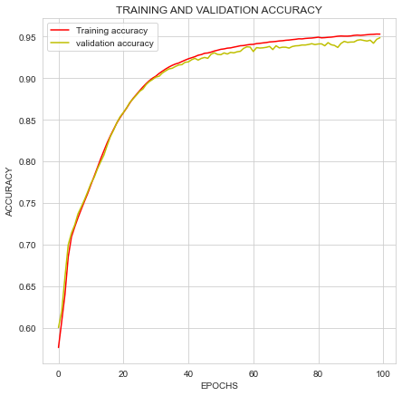
Win Prediction using deep learning algorithm results :
The model gives a very good and identical training and validation fit.
At the end of 50 epochs, It gives the following results :
Training accuracy : 0.9530
Validation accuracy : 0.9487

Slide 24
Ball by Ball Score Predictor
A deep learning model having 2 hidden layers having 300 and 90 nodes, along with an input layer with 7 nodes and an output layer with 1 node, having ‘swish’ activation function was created using keras-tensorflow and run for a total of 50 epochs. These numbers were finalized after a lot of experimenting and trial and error.
The input data has the same structure as that of the score predictor using the other machine learning algorithms, with the same 80-20 test-train split to segregate the training and the validation data.
The results of the model are given in the next slide

Slide 25
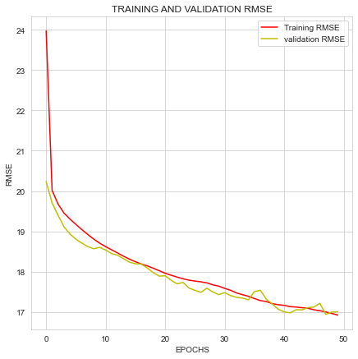
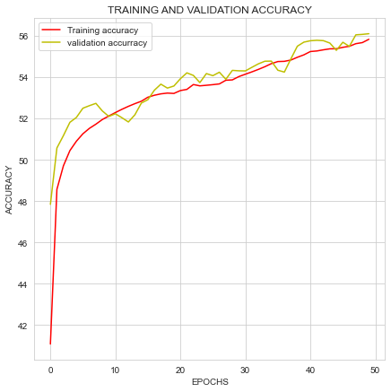
Score prediction using deep learning algorithm results :
At the end of 30 epochs →
Training RMSE : 16.92 ; Validation RMSE : 17.01 | Training Accuracy : 55.83 ; Validation Accuracy : 56.10

Slide 26
References :
https://www.kaggle.com/nowke9/ipldata?select=matches.csv [data]
https://seaborn.pydata.org/
https://matplotlib.org/stable/api/index.html
https://www.kaggle.com/eshaanmane/eshaan-ipl-notebook#ball-level
https://colab.research.google.com/drive/1dnT8wZo3-SNwUbvuwjGzBz4amuUteAqg?usp=sharing
https://colab.research.google.com/drive/1WyjOVde6KLDtvKADSn4FHFLWmGKODdAZ?usp=sharing

Slide 27
THE END

